Slide 1
Travel Agent Problem
Brent Usui

Slide 2
Final Solution
By using the closest neighbor algorithm, the round trip came out to 12,997 miles (originally was 19,803 miles)
I believe that the solution can be the optimal solution for this problem since it creates a path by using the shortest distance available to the cities

Slide 3
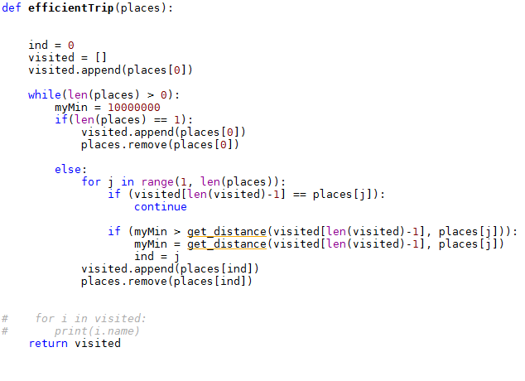
Code

